Slide 1

Solar Power Plant design

Slide 2
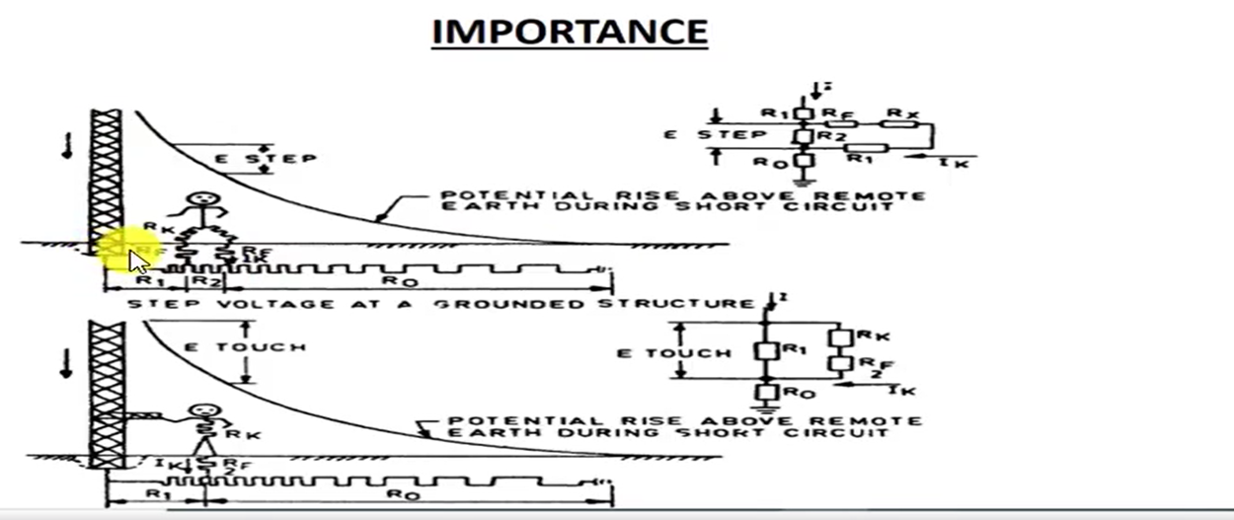

Slide 3
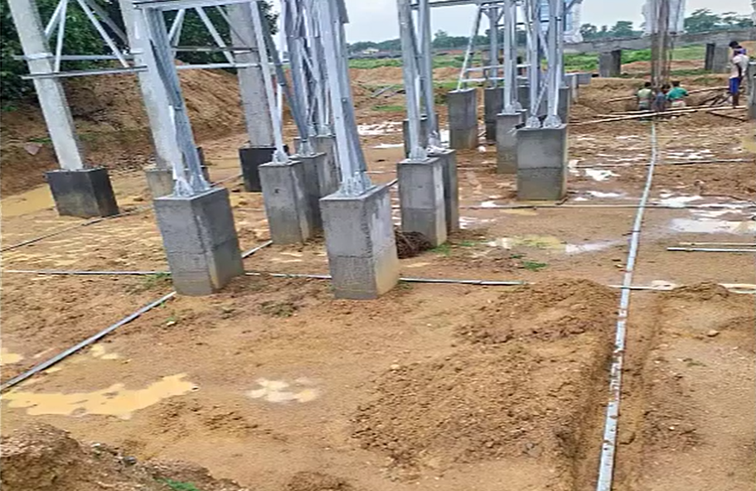

Slide 4
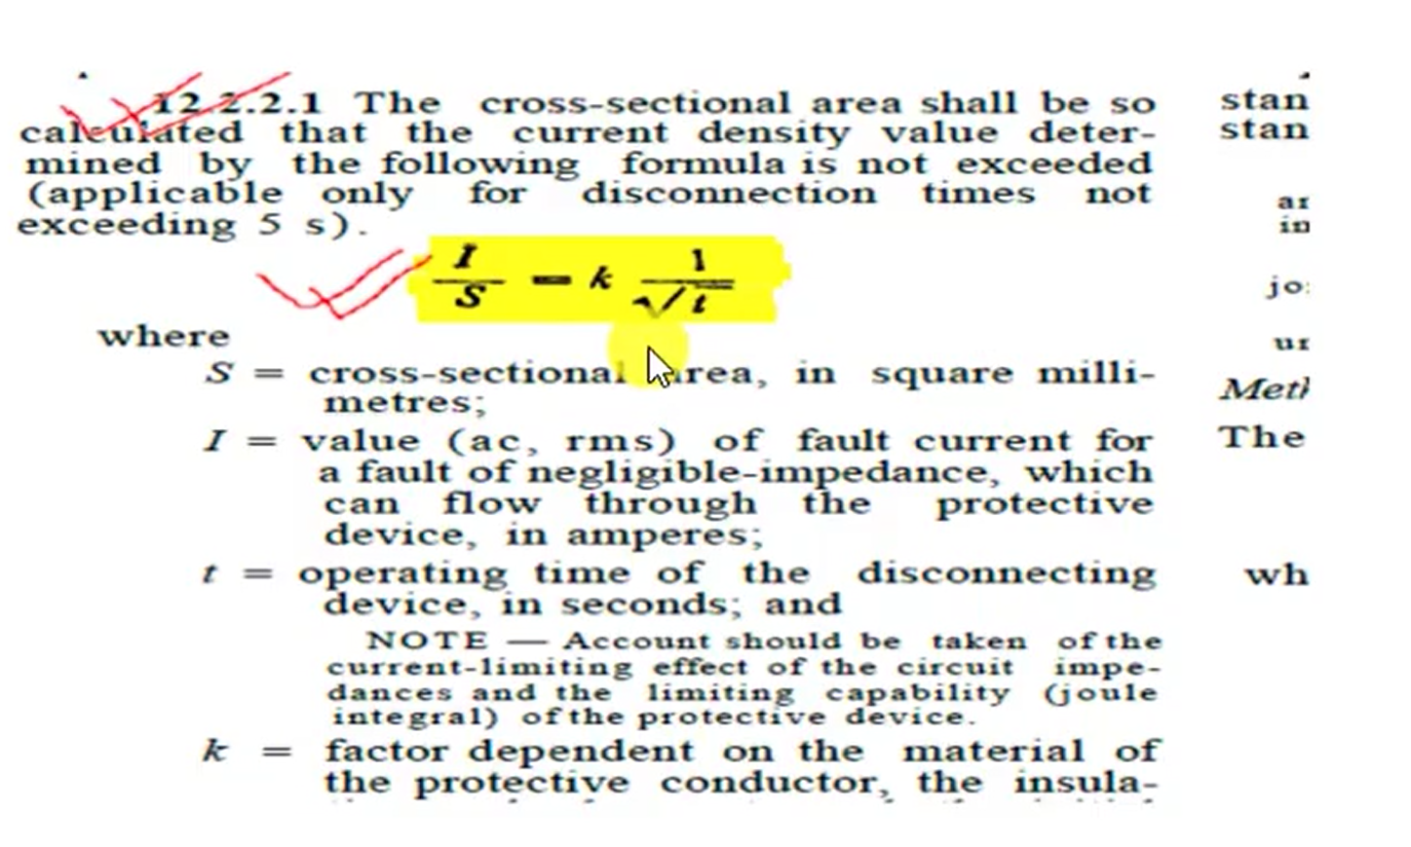

Slide 5
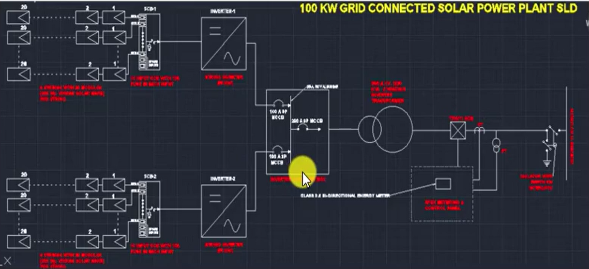

Slide 6
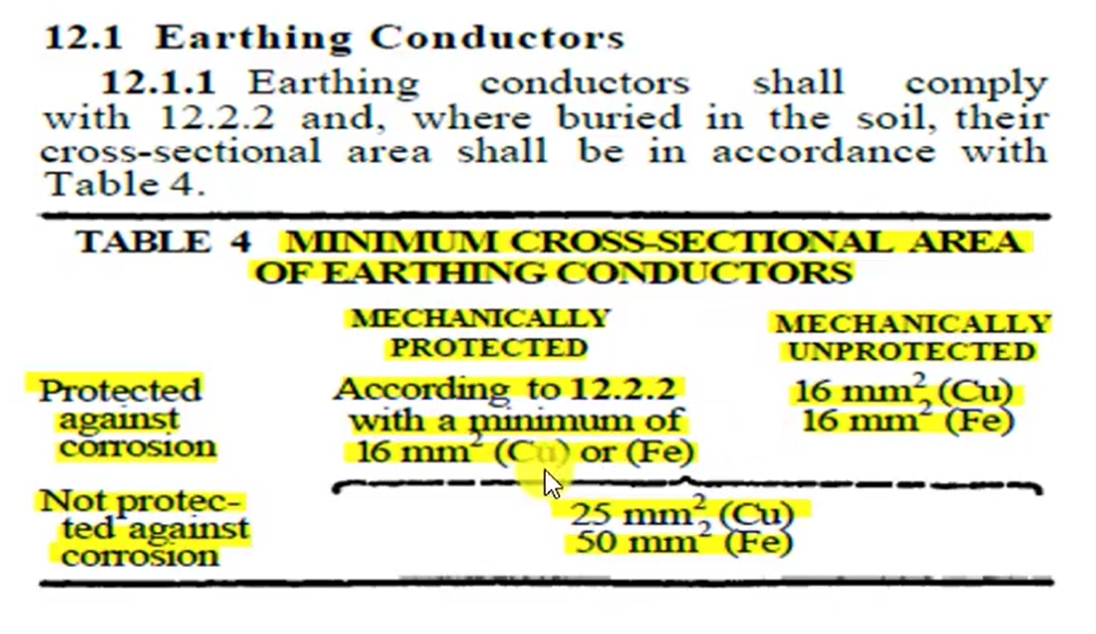

Slide 7
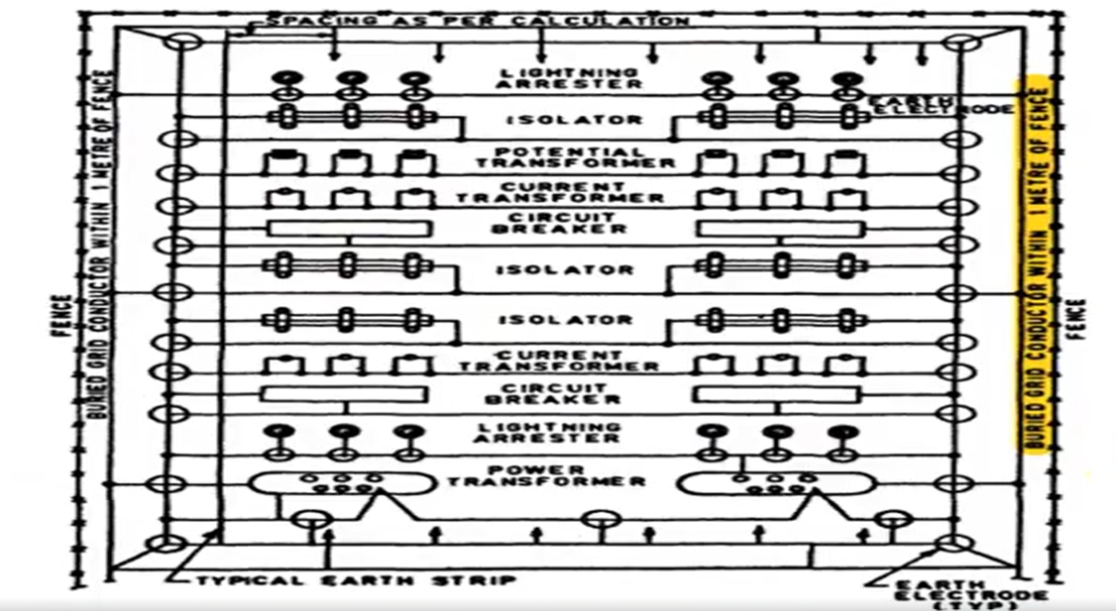

Slide 8
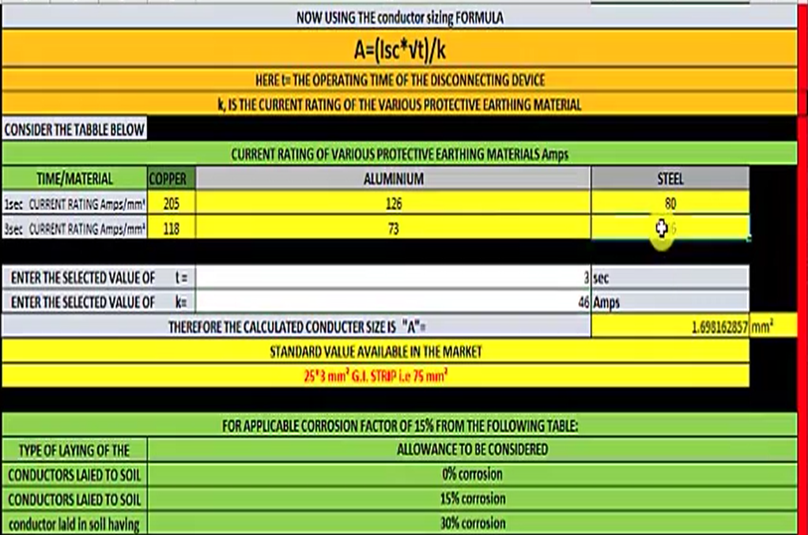

Slide 9
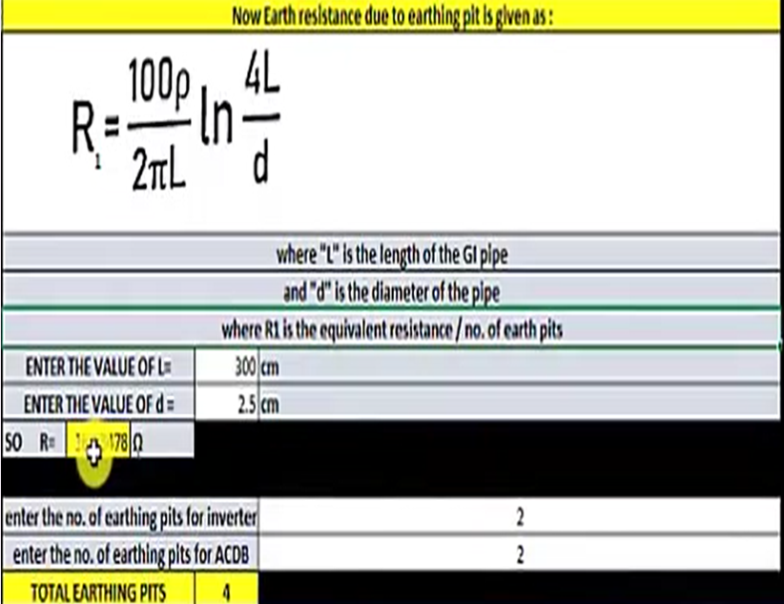

Slide 10
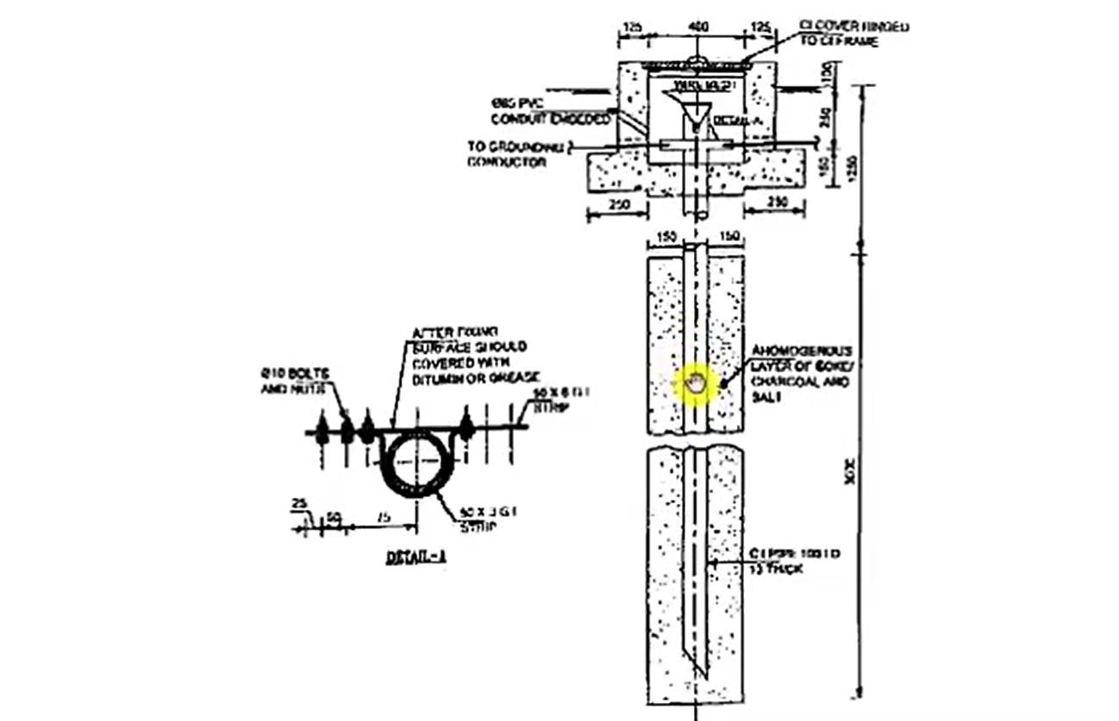

Slide 11
Good Practice-(Earthing of SPP)
1. Individual EP value <5 Ohms
2. Grid EP value <1 Ohms
3. AC & DC earth grid should be separate
4. LA should have separate/dedicated EP
5. In case of central inverter, AC & DC section should be provided with dedicated EP

Slide 12
Thank You

